Slide 1
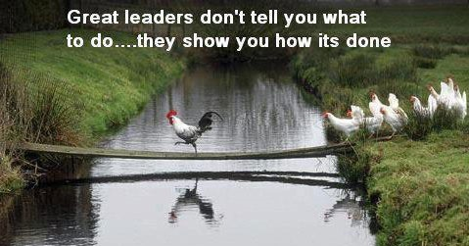
OVERCOMING SYSTEMIC CHALLENGES
PARTICIPANT GROUP:
PRINCIPAL DISTRICT JUDGES
RESOURCE PERSON:
ADVOCATE MICHELLE MENDONCA

Slide 2
Session Objectives
To explore tools to help judiciary effectively deliver timely justice
Through developing more control over circumstances
Through double-loop thinking

Slide 3

Effectiveness by Gaining Control Over Our Circumstances
RESOURCE PERSON:

Slide 4

Discussion
Why are some people successful in the same circumstances while others fail?
Test for locus of control

Slide 5
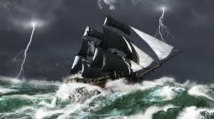
Are You the Master of Your Fate?
  When something good happens do you credit your actions or your luck
  When something bad happens do you take responsibility to link it to fate

Slide 6
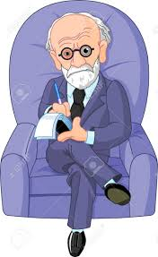
Locus of Control?
  Julian Rotter, a behavioural pyschologist, developed the concept of locus of control
  People with an external locus of control place responsibility for behavioural consequences on luck, fate, other people etc.
  People with an internal locus of control place responsibility for behavioural consequences on their own behaviour and personality characteristics

Slide 7
Video
  Discussion
  What are the 2 kinds of responses the Israelis could have made?
  Why did they respond the way they did?

Slide 8
Can we Change our Locus of Control?
  Locus of control is developed through childhood learning, culture and life experiences
  Can we unlearn this?

Slide 9
Circles of Control, Influence, Concern
  Circle of Concern: Situations that affect us but we can do nothing about (your past, global issues, terrorism)
  Circle of Influence: Situations we can influence but not control (situations involving other people’s behavior)
  Circle of Control: Situations we can control (situations involving our own behavior)

Slide 10
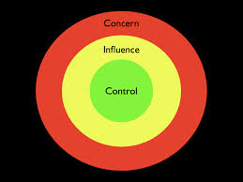
  Circle of Control: Situations we can control (situations involving our own behavior)
  Circle of Concern: Situations that affect us but we can do nothing about (your past, global issues, terrorism)
  Circle of Influence: Situations we can influence but not control (situations involving other people’s behavior)

Slide 11
LARGE GROUP DISCUSSION
  What are the challenges you find most difficult, almost impossible?

Slide 12
SMALL GROUP DISCUSSION
  For each factor and circumstance that emerged from the large group discussion, divide into small groups and plot the factors in the circles

Slide 13
Conclusion of Exercise
    Presentation
    Summary of learnings

Slide 14

Effectiveness Through Double-Loop Thinking
RESOURCE PERSON:

Slide 15
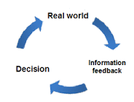
SINGLE LOOP V. DOUBLE LOOP THINKING
  Single Loop thinking: what should I do?
  Double Loop thinking: why am I doing what I am doing?
  Double Loop thinking leads to innovation

Slide 16
SMALL GROUP DISCUSSION
  Each group will discuss a scenario and answer the following questions:
    What is the goal of this activity I am conducting (in the scenario)
    How can I perform the activity in a way that leads to the goal?
    Before starting on the discussion, each group will share its goal with the larger audience

Slide 17
Conclusion of Exercise
    Presentation
    Summary of learnings

Slide 18
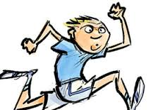
CONCLUSION
    Remember Roger Bannister and the 4-minute mile

Slide 19

FEEDBACK
:

Slide 20

HANK YOU
:

Slide 21
Acknowledgments
    Julian Rotter: Locus of Control
    Stephen Covey: Circles of Control, Influence and Concern
    Chris Argyris: Double Loop Learning
    Eng Hoe: Paradigm Shift

